Slide 1
Learning Strategies for Students: Learning Disability
Encouraging, supportive classroom
Student made to feel a valued member of class
Recognize efforts, improvement and task completion
Opportunities for positive self-expression, beginning first in a small group setting

Slide 2
Learning Strategies for Students: Learning Disability
Attach daily schedules,/timetables to student notebook
Have a buddy system
Allow more time on assignments
Encourage alternate forms of presentation, e.g. spoken instead of written
Encourage risk-taking

Slide 3
Learning Strategies for Students: Learning Disability
Involve students in setting goals for completion of work
Use manipulatives, visuals and lots of hands-on activities

Slide 4
Learning Strategies for Students: Learning Disability
Adaptive technology
SQ4R and Kurzweil 3000
GRADES and textHELP
SQ3R Survey, Question, Read, Recite, Review
PARS Preview, Ask questions, Read, Summarize for younger students

Slide 5
Learning Strategies for Students: Learning Disability
REAP Read, Encode, Annotate, Ponder
ReQuest reciprocal questioning Teacher and student take turns asking questions on initial sentences in a selection prior to reading and to base reading activities on anticipated questions. Person responding to questions has book closed.

Slide 6
Learning Strategies for Students: Learning Disability
RAP Read, Ask questions, Paraphrase
Plan, Write and Revise Opinion Essays
SNAP See problem, Name plan, Act on plan, Pat on back
SRE Scaffolded reading experience
Time management

Slide 7
Learning Strategies for Students: Learning Disability
COPS Capitalization, Overall appearance, Punctuation, Spelling and Sentence Structure
TOWER Think, Order ideas, Write, Edit, Rewrite for writing assignments

Slide 8
Learning Strategies for Students: Learning Disability
Look at the picture
Think about the story
Try a word. Does it sound like one you know?
Read the whole sentence-go back and try a word. Does it make sense?

Slide 9
Strategies for Reading Unknown or Forgotten Words
Look at 1. The first letters
2. The middle letters
3. The ending
If you still can’t get the word quickly keep reading.
It is not necessary to read every word all of the time.

Slide 10
SPECO
Spelling
Punctuation, : ? ! ” ”
Endings, s, es, ed, d, ing
Capitals
Omitted (words left out)

Slide 11
SPECO
Write SPECO at bottom of page
Place a checkmark above each letter in SPECO
Teacher may assign all or part of SPECO
Teacher marks work for errors and makes a notation below appropriate letters or in the margin beside the error

Slide 12
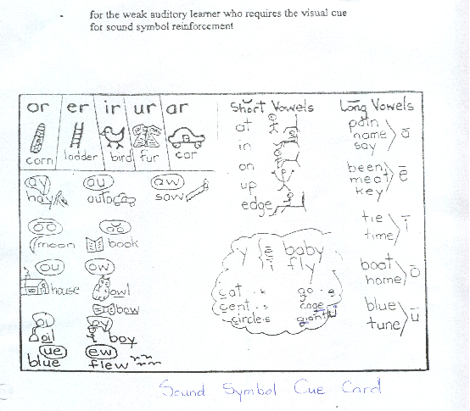

Slide 13
Learning Strategies for Students: Learning Disability
SCORER strategy for test-taking
Schedule time
Look for Clue words
Omit difficult questions
Read carefully
Estimate answers
Review the work

Slide 14
Learning Strategies for Students: Learning Disability
SQRQCQ assists with word problems in Math
Survey of the word problem
what Question is being asked
Read problem more carefully
Question processes required for answer
Compute answer
Question again to check answer

Slide 15
Problem Solving
Study the problem. Read it-underline the question
Organize the facts-underline the facts
Line up a plan-write down the facts
Verify your plan-with a (= - x /) computation
Examine your answer-check your computation

Slide 16
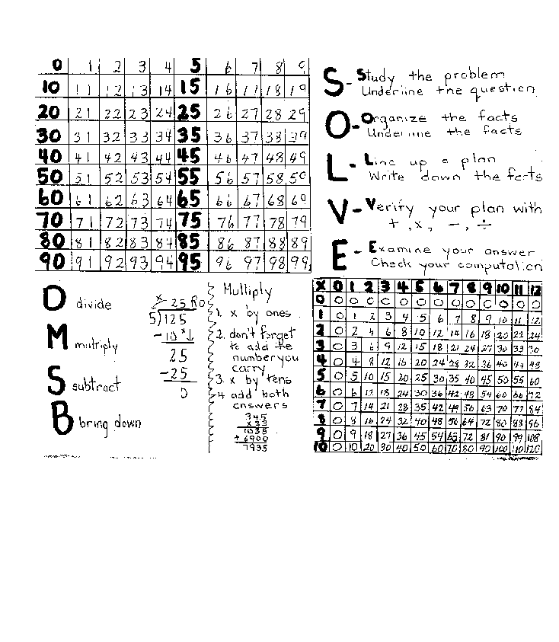

Slide 17
Study Skills Program
Set specific goals
Know individual strengths to select and modify strategies
Know what motivates students
Explain and demonstrate
Provide opportunities for continued practice and guided instruction

Slide 18
Teaching Strategies to improve academic/social life
Incidental teaching-explain a lesson due to conflict in classroom
Analyzing an incident and explain alternatives
Coaching emotional response-explain and handle emotions
Peer tutoring
Collaborative teaching-cooperative learning and problem solving
TTYPA-making connections with a partner

Slide 19
Teaching Strategies to improve academic/social life
Partners thinking aloud-one student is problem-solver and the other is monitor
Cooperative learning

Slide 20
Strategies for Self-Advocacy
Self-awareness: aware of strengths and weaknesses
Career exploration: possible career choices
Self-advocacy: communicate needs, interest, desires and rights
Self-determination: set goals/make choices and reach them to the best of their ability

Slide 21
Continuum of Accommodations
Valid
Develop test-taking skills
Individual administration
Enhanced instructions
Physical accommodations
Large print
Braille

Slide 22
Continuum of Accommodations
Possibly valid
Extended time
Eliminating biased items
Reading content questions
Examiner aid
Calculator for math problems
Using a scribe

Slide 23
Continuum of Accommodations
Invalid
Reading reading-test questions
Eliminating difficult items
Changing test content
Practicing with exact test
Calculator for math facts
Non-authored test responses

Slide 24
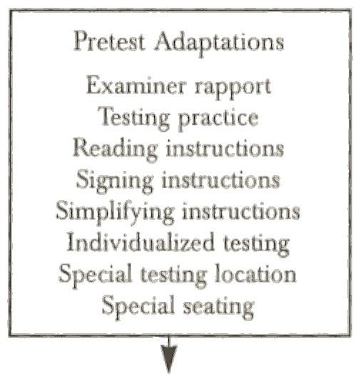
Range of Test Accommodations

Slide 25
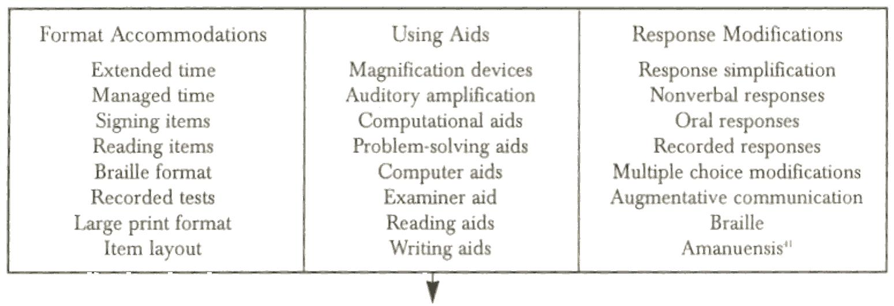
Range of Test Accommodations

Slide 26
Range of Test Accommodations
I
Posttest Accommodations I
Alternative scores
Predicted scores
Using local norms Using special norms
Content interpretation Revised scoring
Response analysis Modified grading

Slide 27
Sources for Determining Test Accommodation Needs
Observational/Anecdotal Sources
Classroom teacher Resource teacher
School psychologist Specialists (reading)
Occupational/Physical therapist
Guidance counselor
Administrator
Assistants Parents Student

Slide 28
Test Accommodation Questions
Is location easily accessible?
Are facilities adequate?
Are oral instructions easily heard?
Is lighting conducive to testing?
Is student able to see/hear examiner?
Is student able to function independently?

Slide 29
Test Accommodation Questions
Does student seem motivated?
Can student cope with frustration?
Does student attend to instructions and task?
Are instructions understood?
Reasonable level of energy?
Test format clear, easy to follow?

Slide 30
Test Accommodation Questions
Task required clear/easy to follow?
Difficulty level appropriate?
Student able to answer without aids?
Language mode (reading) suitable?
Considers entire item and all choices?
Immediate responses after item presentation?

Slide 31
Test Accommodation Questions
Able to perform response required?
Sufficient time?
Can the test norms be used with this student?

Slide 32
Hierarchy of Test Accommodations
No accommodation
Testing adaptations
Testing modifications
Alternative testing
Test exemption

Slide 33
Sources for Determining Test Accommodation Needs
Assessments:
Group achievement tests
Psychological tests, Specialized tests
Standards tests, Classroom tests
Diagnostic Tests and Inventories
Wide-range assessments
CBM, Portfolios

Slide 34
Minimal-impact Aids
Magnification
Hearing amplification
Reading aids e.g. adaptive technology
Writing aids

Slide 35
Response Aids
Examiner recorded response
Examiner interpreted response
Word processor
Synthesized speech
Adaptive technology

Slide 36
Problem-solving Aids
Examiner help
Using calculators
Spellchecker,etc.
Speech recognition
Manipulatives, tables, number lines
Reference materials

Slide 37
